Slide 1
Library management system
22-SE-36 Abdul Ali Shah
22-SE-39 Muhammad Saifullah

Slide 2
Problem domain
Overview:
The library management system aims to efficiently manage the borrowing and availability of books within the library, ensuring smooth operations for both staff and users.

Slide 3
requirements
System:
The features related to the system are:
The system should provide functionalities for adding, updating, and managing library resources such as books, authors, subjects, floors, and shelves.
It should allow staff to issue and return books, generate penalties for overdue books, and handle book extensions

Slide 4
requirements
User:
The system shall be able to incorporate the following users:
Staff member
Teachers
Students

Slide 5
requirements
Books:
Functionality to add new books to the library inventory.
Ability to associate books with authors and subjects.
Issue books:
Capability to issue books to users and track issue dates, return dates, and extensions

Slide 6
requirements
Books:
Functionality to add new books to the library inventory.
Ability to associate books with authors and subjects.
Issue books:
Capability to issue books to users and track issue dates, return dates, and extensions

Slide 7
constraints
The system should ensure data integrity and enforce foreign key constraints.
Performance optimization strategies should be implemented to handle large volumes of data efficiently

Slide 8
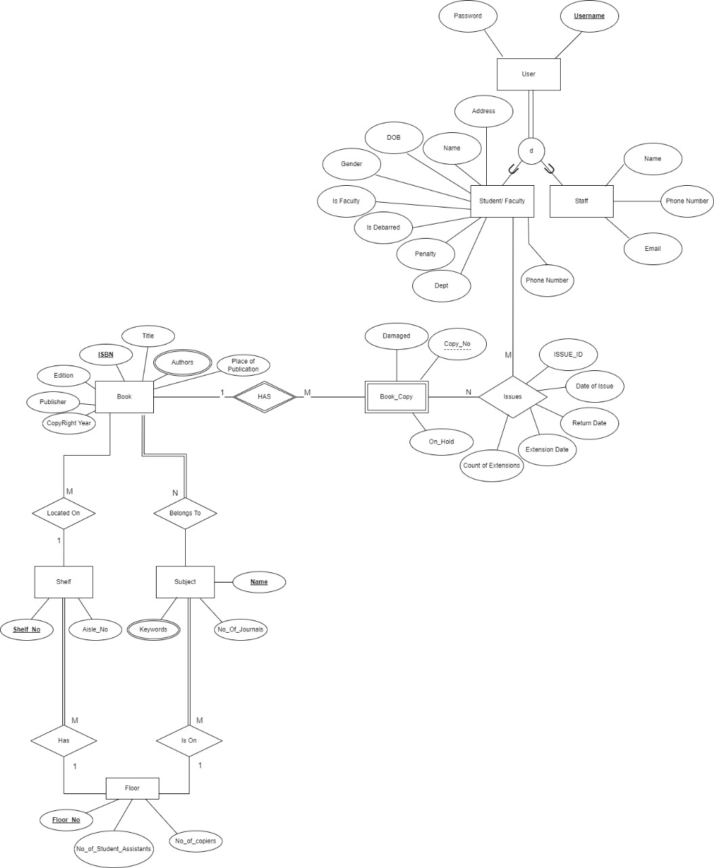
erd

Slide 9
Rationale Behind Design Decisions:
Normalization:
Tables are structured to minimize redundancy and maintain data consistency.
Foreign Key Constraints:
Foreign key constraints are enforced to maintain referential integrity between related tables.
Audit Tables:
Audit tables and triggers are implemented to track changes made to critical data.

Slide 10
Rationale Behind Design Decisions:
Data Integrity:
Constraints such as primary keys, unique constraints, and foreign key constraints are used to ensure data integrity. Default values and constraints are used to maintain data integrity
Scalability:
The system design allows for scalability to accommodate future growth in library resources and users.

Slide 11
Potential Challenges and Strategies
Data Security:
Implement robust authentication and authorization mechanisms to protect sensitive data.
Performance Optimization:
Optimizing database queries and indexing to ensure efficient data retrieval.

Slide 12
Potential Challenges and Strategies
Concurrency Control:
Employ concurrency control mechanisms to prevent data inconsistencies in a multi-user environment.
Error Handling:
Implementing error handling mechanisms to gracefully handle exceptions and ensure data consistency.

Slide 13
Project Implementation
Designing database
The implementation of the database system will involve:
Creating the database schema based on the proposed design.
Implementing SQL scripts to create tables, constraints, triggers, and audit functionality.
Thoroughly testing the system to ensure its functionality, reliability, and security.
Presenting the completed project to showcase its features and functionality to stakeholders

Slide 14
Project Implementation
Build Application
Test System
Document Process
Train Users
Present to Stakeholders

Slide 15
Thank you
22-se-39
22-se-39

